Slide 1
Verifying Lingua Franca using UCLID5
Shaokai Lin
Presentation in the UCLID5 Group
9.18.20

Slide 2
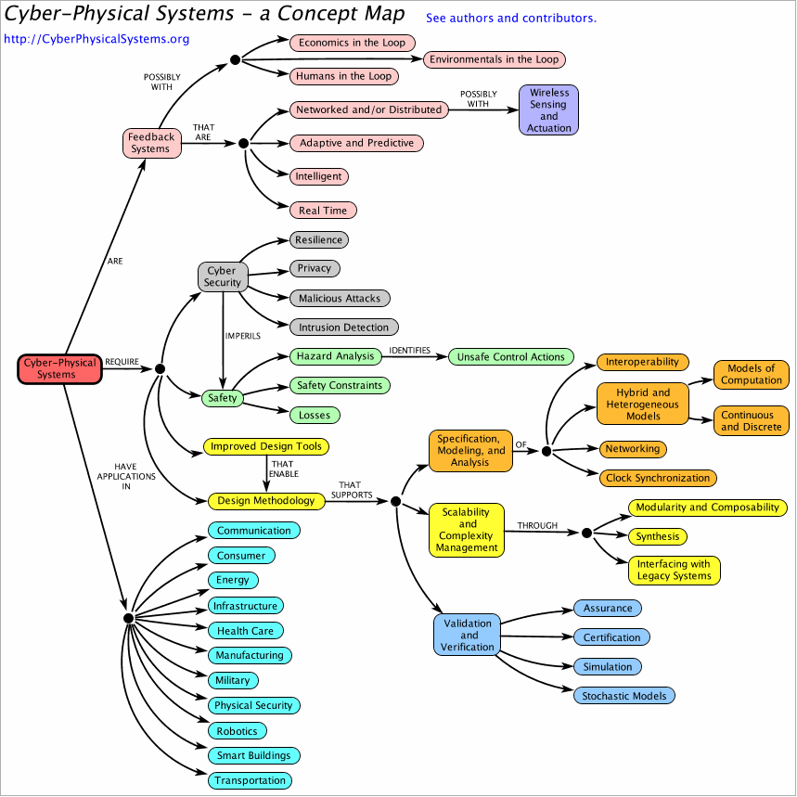
Cyber-Physical Systems (CPS)

Slide 3
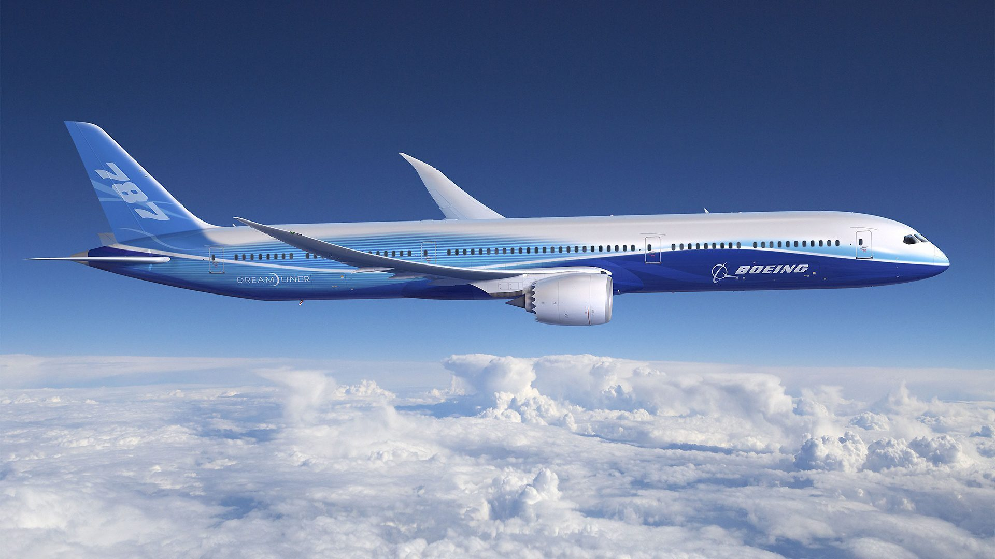
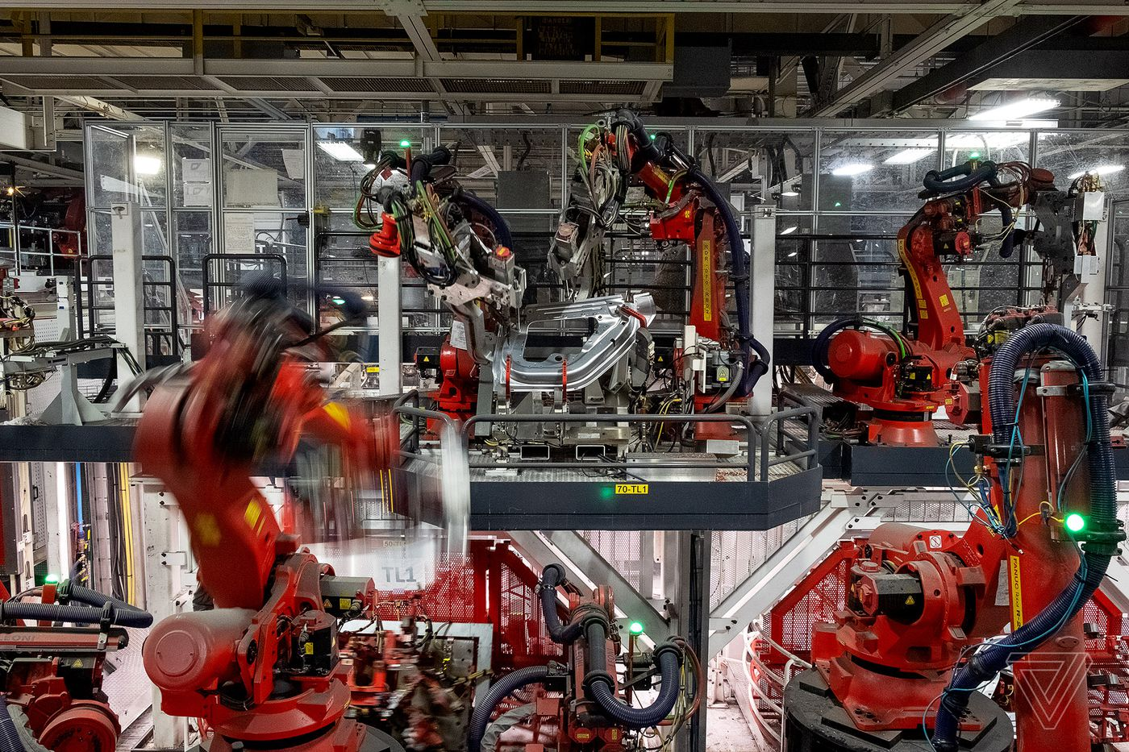
Cyber-Physical Systems (CPS)

Slide 4
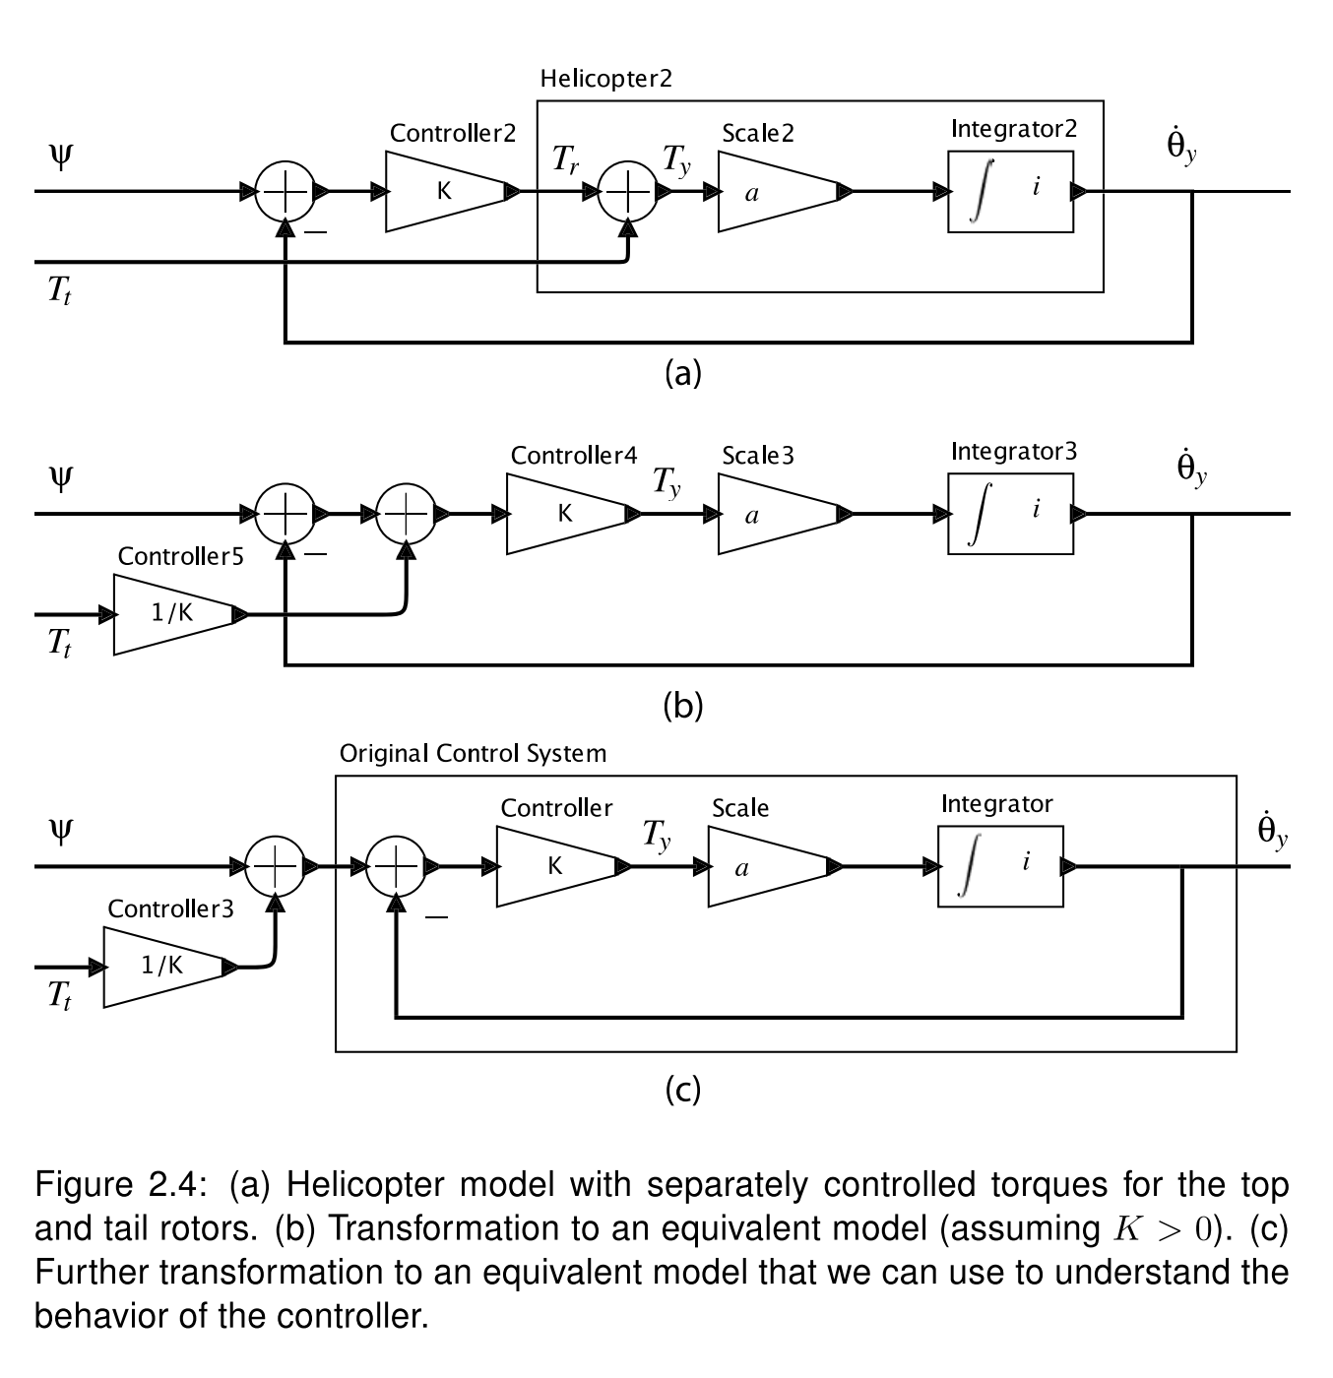
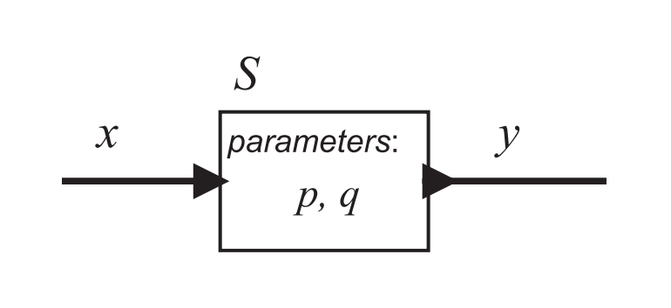
Actor Model
A mathematical model for describing concurrent systems
“Actor” is the universal primitive
An actor can send messages, react to incoming messages, and create more actors.
[Lee & Seshia., 2017]

Slide 5
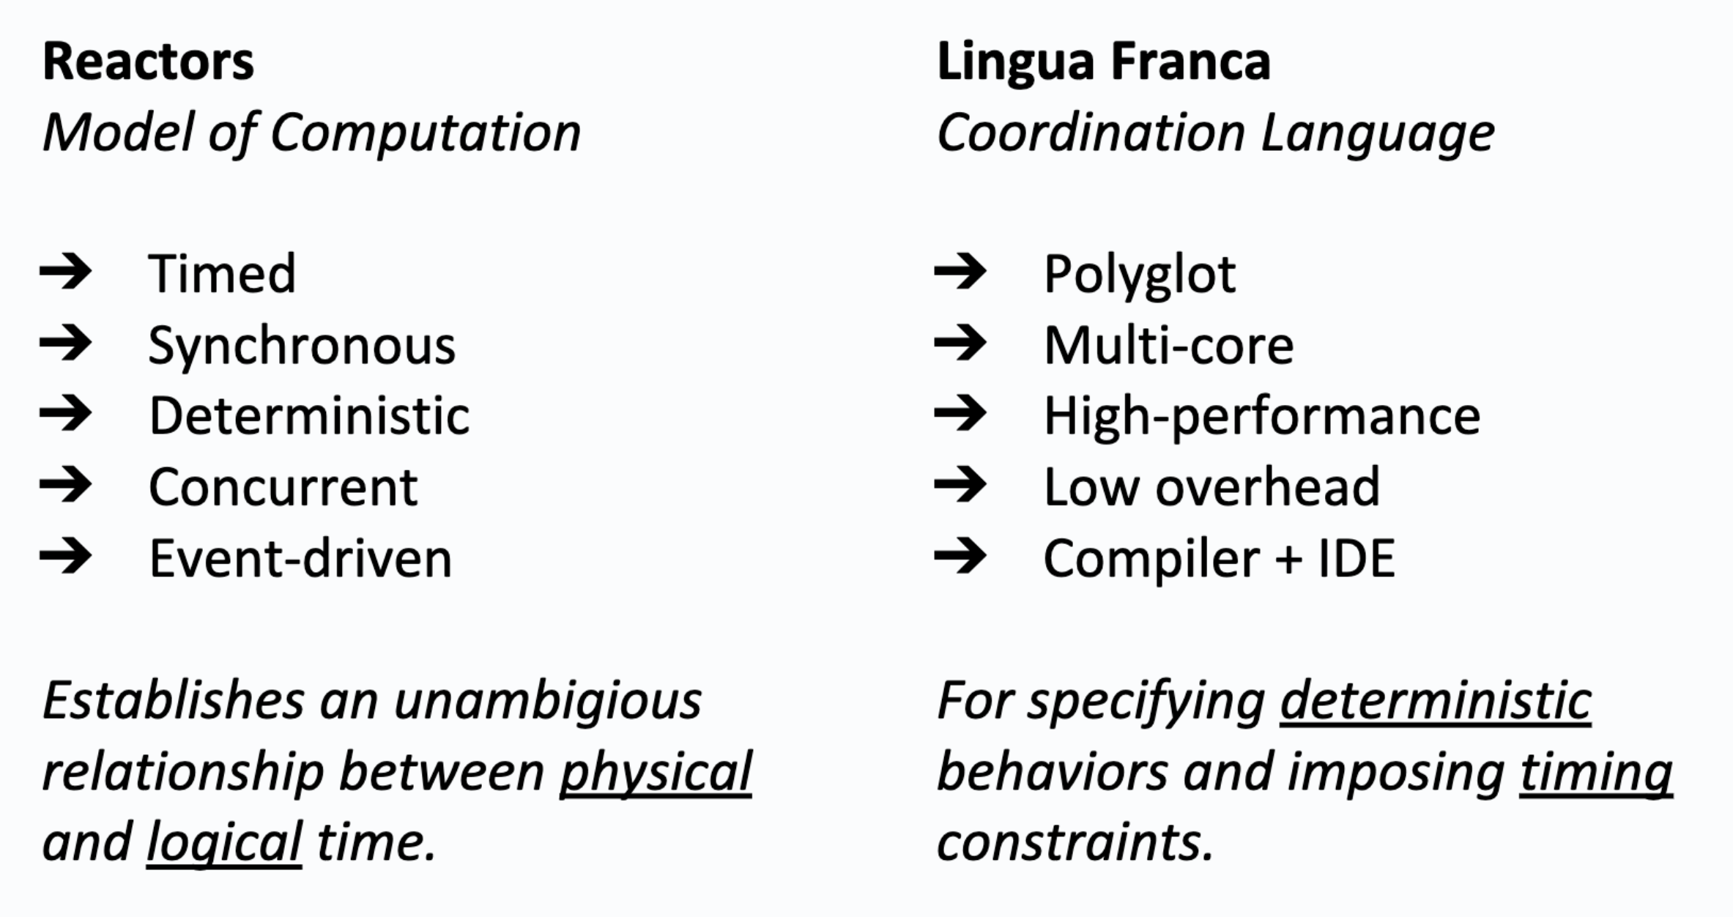
Reactors and Lingua Franca (LF)
Github: https://github.com/icyphy/lingua-franca
[Lohstroh et al., 2019]

Slide 6
Verifying Cyber-Physical Systems
Cyber
Physical
For the cyber part alone, there are a few questions to consider:
Correctness of reaction code
Schedulability
Single-threaded, multi-threaded, distributed executions
Uncertainties (network delay, sensor output, etc.)
Properties related to these questions can be specified using pre/post conditions, and Linear Temporal Logic (LTL).

Slide 7
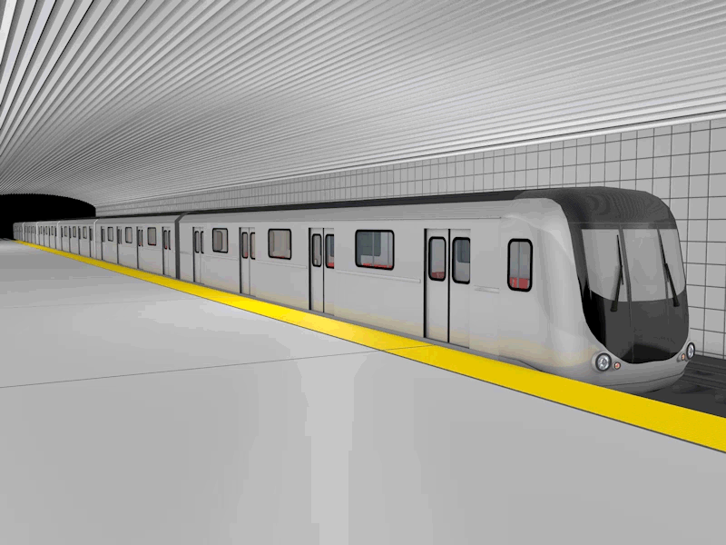

Train Door Example
Mode 1:
Door unlocked,
Train stopped
Press button
Mode 2:
Door locked,
Train moving
What if Controller, Train, and Door are separated by a network?
Unsafe state: unlocked & moving

Slide 8
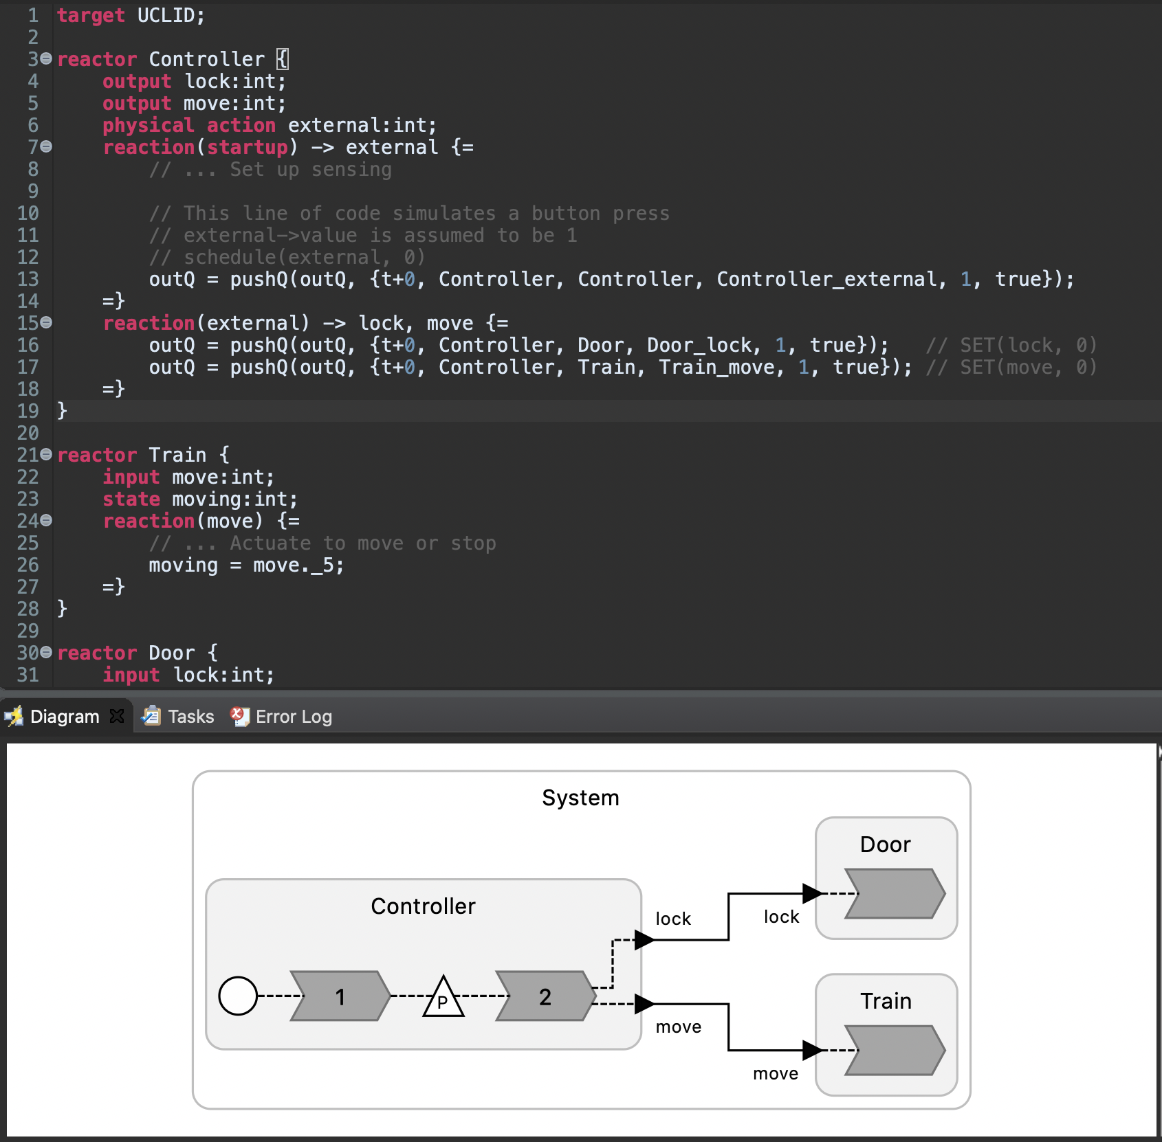
A Quick Demo

Slide 9
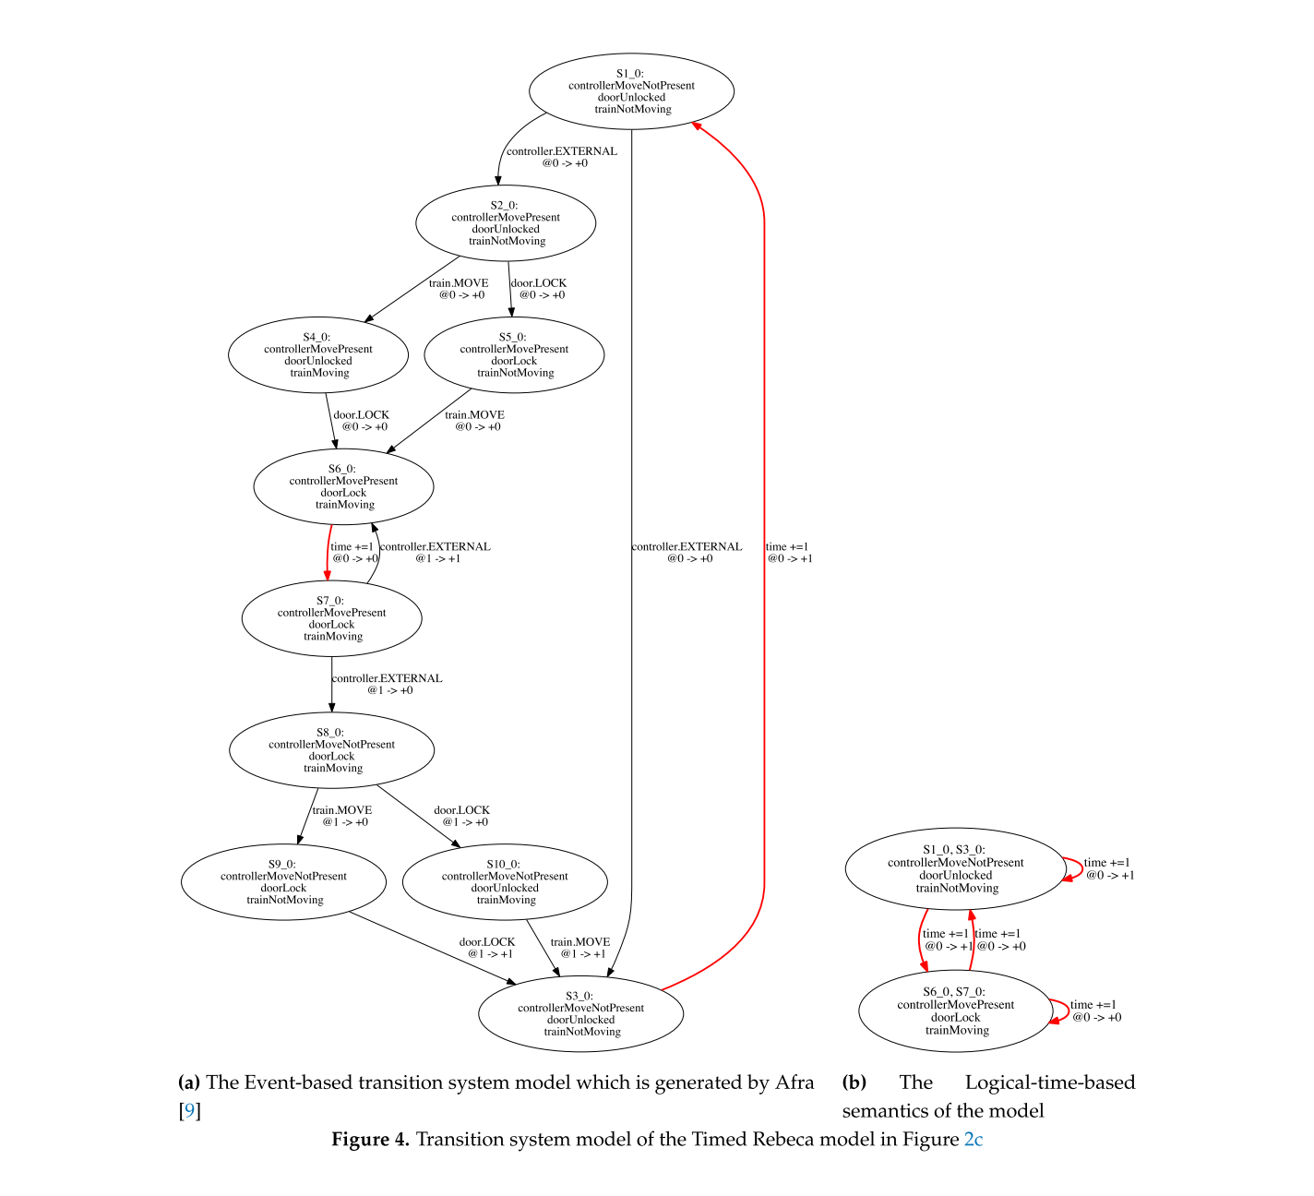
[Sirjani et al., 2020]

Slide 10
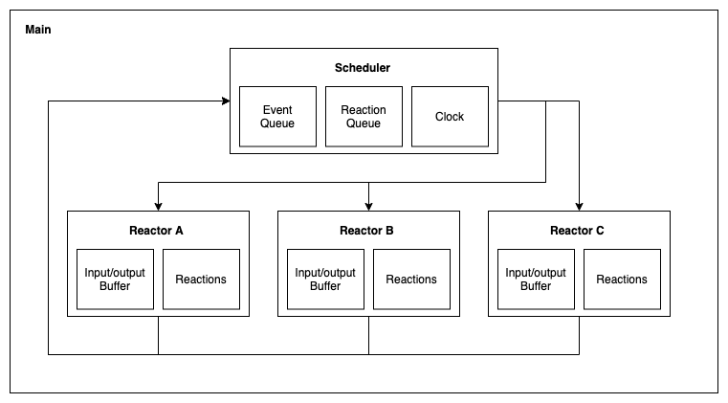
Mapping LF into UCLID5

Slide 11
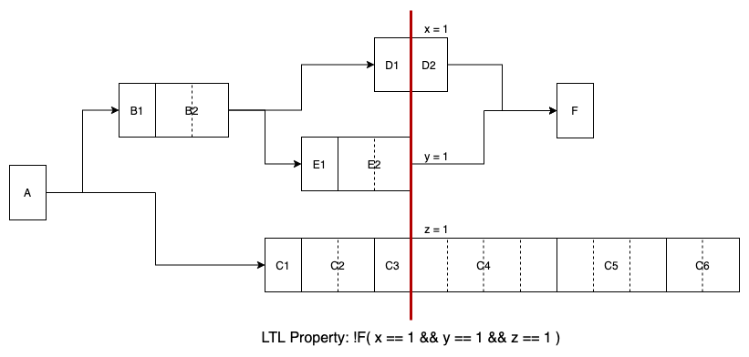
In Progress
Concurrent semantics
To account for more execution environments
To check for subtle unsafe states during concurrent executions
Proof by induction
To obtain unbounded guarantees

